Slide 1


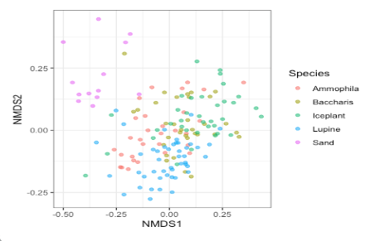
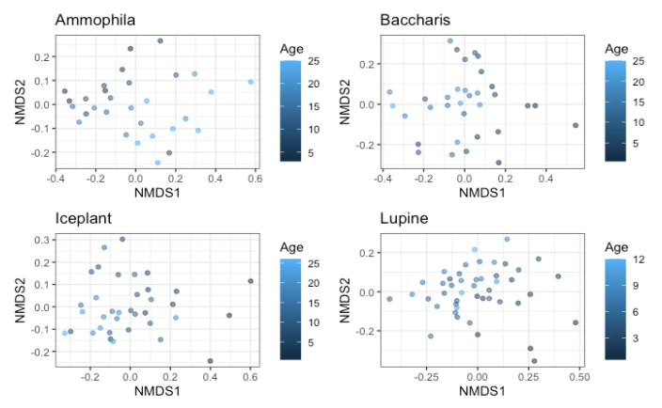
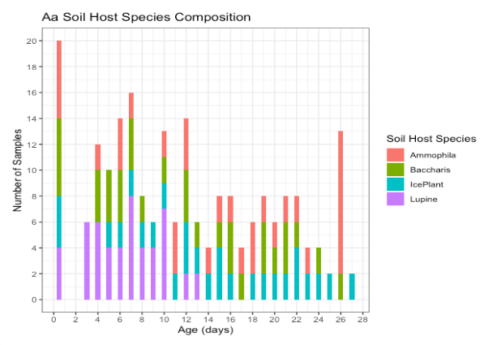
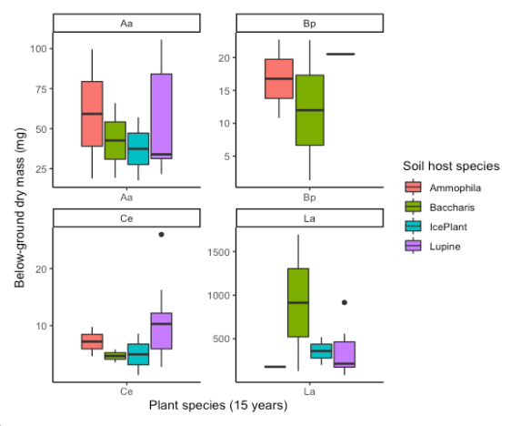
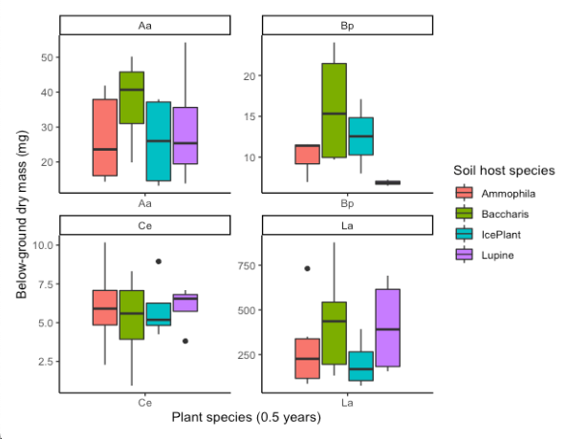
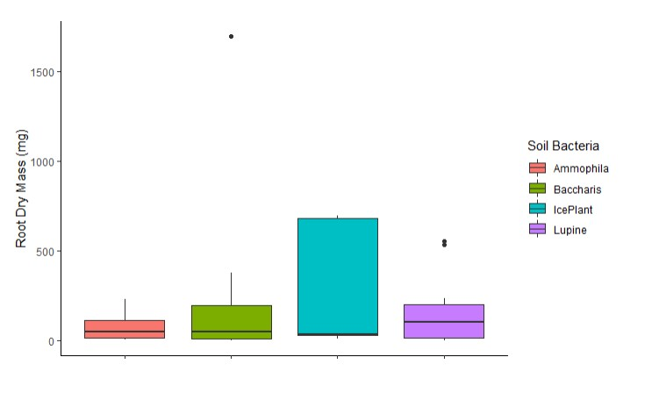
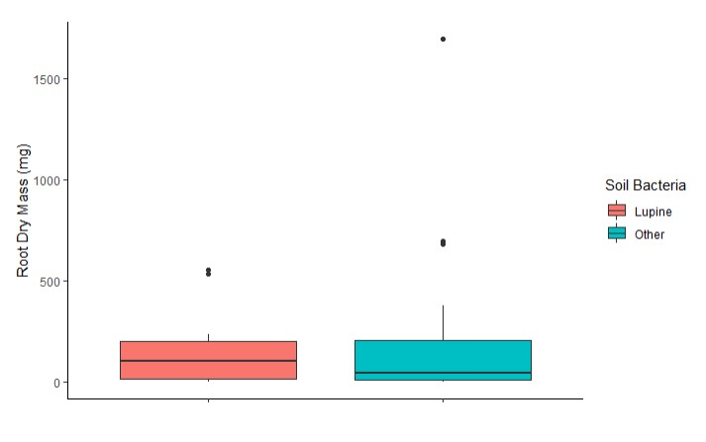
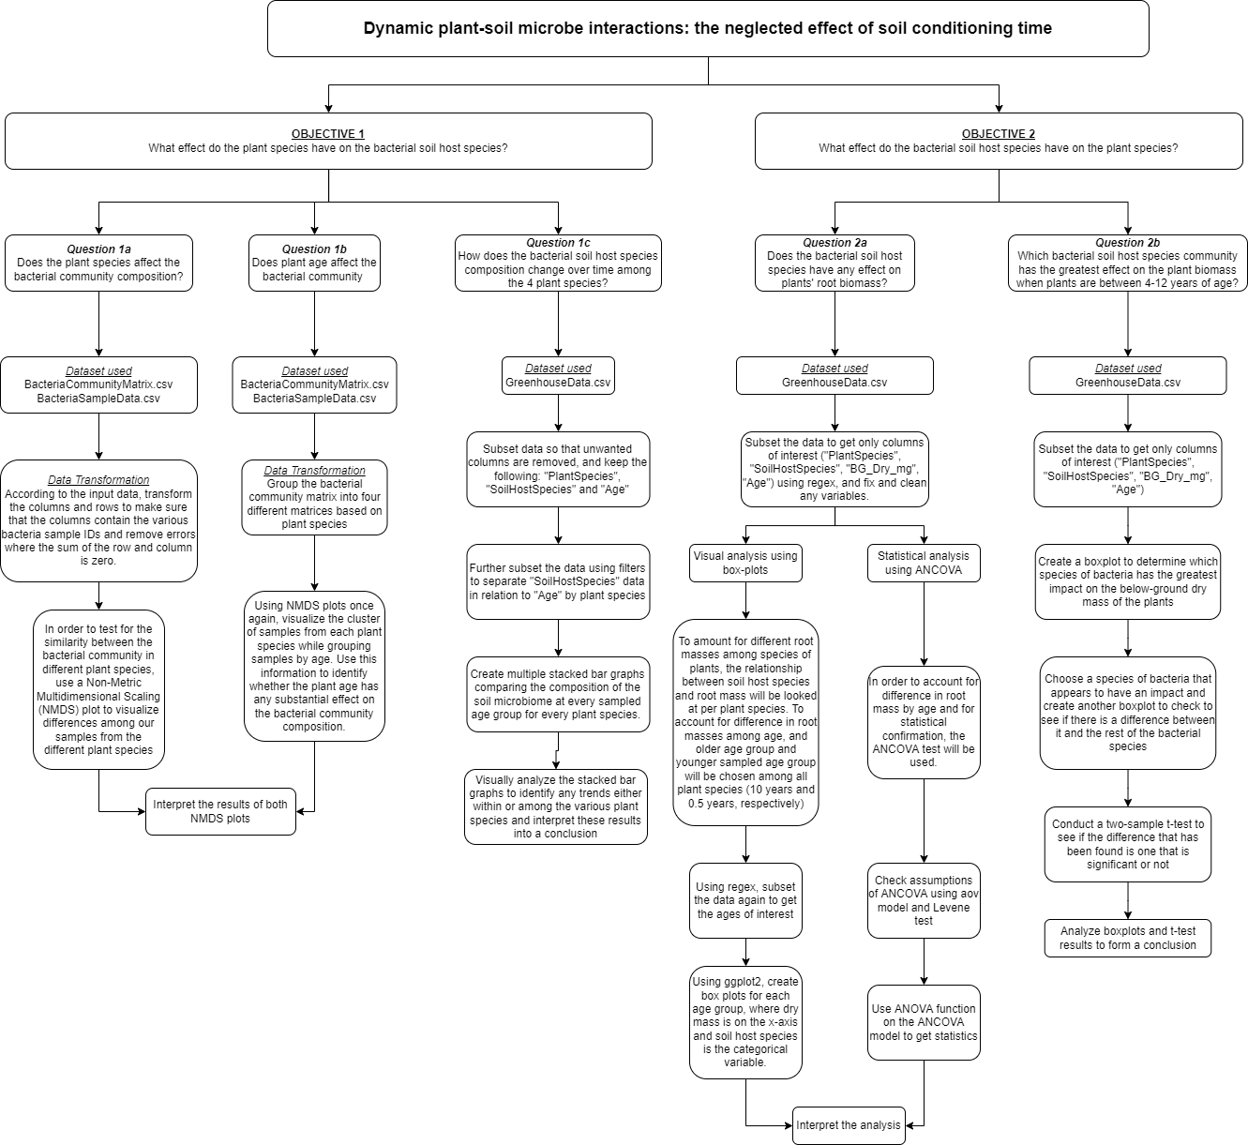
Plant-Soil Microbe Interactions and
Effects on Plant Biomass
Roshael Chellappah, Tram Duong, Tianyi Zuo, Malcolm Stewart
BIOL 432 - Computation and Big Data in Biology, Queen’s University
Introduction
Soil microbial communities can play a key role in building plant communities. Individual plants frequently cause changes in soil microbial community composition, and this reciprocal change then continues to affect the growth of neighboring plants or individual plants that subsequently colonize the soil. As this effect increases, it can cause interspecific differences and thus affect plant community composition. In addition, the intensity of this interaction varies over time. In our data, the experimenters mainly collected changes in the soil microbial community associated with individuals of four plant species for more than 20 years. Using this data, we explore how the intensity of the interaction between plant and microbial populations varies over time.
Results
Figure 1. NMDS plot showing overall variation in bacterial community composition among the various plant species
Figure 2. NMDS ordination plot depicting microbial community composition as a factor of plant species and plant age
Figure 3A. Stacked bar graph depicting bacterial community composition in soil of sampled Ammophila arenaria plants as they age.
OBJECTIVE 1 – Identify if plant species have any effect on bacterial soil host species
Do plant species have any effect on bacterial soil host species composition?
Does plant age effect bacterial soil host species composition?
How does bacterial soil host species composition differ as each plant species ages?
Hypothesis: We believe that there will be a clear distinction between bacterial soil host compositions between the various plant species, and that the bacterial composition will differ as plants age.
OBJECTIVE 2 – Identify if bacterial soil host species have any effect on the studied plants
Do the bacterial soil host species have any effect on plant below-ground dry mass?
Which bacterial soil host species has the greatest effect on plant root dry mass when plants are between of 4 – 12 years of age?
Hypothesis: We expect the plants to have greater root biomass when the plant species transplanted seedling) and bacterial soil host species are the same. We also believe that there may be a particular bacteria that has the greater effect on the plant root biomass when plants are 4-12 years old.
Research Questions & Hypothesis
Figure 4. Soil host species and below-ground dry mass of each plant species at 0.5 years of age
Figure 5. Soil host species and below-ground dry mass of each plant species at 10 years of age
Methods
Figure 6. Relationships between the various bacterial soil host species and root dry mass
Figure 7. Difference in root dry mass between Lupine bacteria and all other species of soil host bacteria
Conclusion
Our data suggest that plant-soil microbial interactions do exist, but we were not able to demonstrate whether the strength of this interaction is affected by the age of the individual plant. Although soil host species compositions differ among the various sampled ages of each plant species, it is difficult to conclude whether this difference is statistically significant. This same conclusion was encountered when analyzing the impact of soil microorganisms on plant root dry mass. Although some relationship between the bacterial community and plant root dry mass was identified, these realtionships were not found to be statistically significant. These conclusions differ from the results obtained in our data source article. Subsequent studies could focus more on whether the length of soil conditioning of plants affects the strength of this interaction and should allow for more appropriate placement of experimental results in natural settings to predict better how soil microbes affect plant community assembly.
Works Cited
Ke, P., Zee, P. C., & Fukami, T. (2021). Dynamic plant–soil microbe interactions: the neglected effect of soil conditioning time. New Phytologist, 231(4), 1546–1558. https://doi.org/10.1111/nph.17420
Ke, P.-J., Zee, P., & Fukami, T. (2021). Dynamic plant-soil microbe interactions: the neglected effect of soil conditioning time. Zenodo. https://doi.org/10.5061/dryad.tmpg4f4zd

